Slide 1
Simple IP Implementation
2021-2 CoMputer network

Slide 2
IP
IP is used for packets to be delivered to their destinations.
At each router, next-hop determination is executed for delivery.

Slide 3
Next-hop determination
First, it finds routing table entry which has the longest matching prefix.
A routing table entry consists of destination, next-hop and output interface.
Destination | Next-hop | Output interface

Slide 4
Next-hop determination example
If the destination of a packet is “123.123.123.1” and a routing table is configured as follows,
Next hop : Direct forwarding - (123.123.123.1)
Destination | Next-hop | Output interface
123.123.0.0/16 | 123.123.1.1 | interface 2
123.123.123.0/24 | :: (Directly connected) | interface 1
Longest matching

Slide 5
Next-hop determination example
If the destination of a packet is “123.123.111.1” and a routing table is configured as follows,
Next hop : 123.123.1.1 (Indirect forwarding)
Destination | Next-hop | Output interface
123.123.0.0/16 | 123.123.1.1 | interface 2
123.123.123.0/24 | :: (Directly connected) | interface 1
Longest matching

Slide 6
Assignment
Implement pseudo-IP
In this assignment, pseudo-IP uses the following header structure and its ethertype is 0xfffe.
dest mac
src mac
Ethertype (0xFFFE)
Pseudo-IP dst IP length (2 octets) | Pseudo-IP dst IP (Variable string )
Pseudo-IP src IP Length (2 octets) | Pseudo-IP src IP (Variable string)
Time To Live (1 octet) | Data payload

Slide 7
Environment
Seongbukgu
Seongbukgu Anamdong
VM1’s Interface a – Dongdaemungu 1
VM2’s Interface a – Dongdaemungu 2
VM2’s Interface b - Sungbukgu Anamdong 1
VM2’s Interface c – Sungbukgu Bomundong 1
VM3’s Interface a – Sungbukgu Anamdong 2
X’s Interface a – Sungbukgu Bomundong 2
a
VM3
Dongdaemungu
b
VM1
VM2
a
a
Seongbukgu Bomundong
c
X
a

Slide 8
Assignment
Implementation
Upper layer de-multiplexing using Ethertype
Implement blanked function
Finding routing entry and next-hop determination
Ex) If VM2 receives a packet from VM1 and its destination is Seongbuk-gu Anam-dong 2/(String Length = 23)
=> Forward the packet through interface b
TTL check
Finding ARP cache entry
Adding Header and Send
VM2’s Routing Table
Destination | Next-hop | Output interface
Dongdaemungu/12 | :: (Directly connected) | a
Sungbukgu Anamdong/18 | :: (Directly connected) | b
Sungbukgu Bomundong/19 | :: (Directly connected) | c

Slide 9
Assignment
VM1’s Routing Table
Destination | Next-hop | Output interface
Dongdaemungu/12 | :: (Directly connected) | a
Sungbukgu Anamdong 1/20 | Dongdaemungu 2 | a
Sungbukgu Anamdong 2/20 | Dongdaemungu 2 | a
Sungbukgu Bomundong 1/21 | Dongdaemungu 2 | a
Sungbukgu Bomundong 2/21 | Dongdaemungu 2 | a
Dongdaemun-gu
Destination MAC address : MAC address of VM2 interface a
Source MAC address : MAC address of VM1 interface a
Destination pseudo-IP address : Sungbukgu Anamdong 2
Source pseudo-IP address : Dongdaemungu 1
VM1
VM2
a
a
Packet

Slide 10
Assignment
(Not implementation)
3. Without default gateway entry, how can you reduce the number of VM1’s routing table entry?
4. How can you configure the default routing entry of VM1?
In your report, write your answer and reason about above questions. (Consider the network topology illustrated in previous slides.)

Slide 11
Submission List
Code
If the code you submitted cannot be compiled, you will get some penalty. (Not zero score)
Test case
Sending a packet to Sungbukgu Anamdong 2 (TTL 4)
Sending a packet to Sungbukgu Anamdong 2 (TTL 1)
Sending a packet to Sungbukgu Bomundong 2 (TTL 3)
Report
How code? (Explain your code execution)
Answers to Question 3, 4
.hwp, .word, .pdf
* Compress your code and report. Then, submit the compressed file.
Due date : 11/24 (Wed) 23:59 (Late submission is not accepted)

Slide 12
Environment Setup
Seongbuk-gu
Seongbuk-gu, Anam-dong
(10.1.2.0)
a
VM3
Dongdaemungu
(10.1.1.0)
b
VM1
VM2
a
a
Seongbuk-gu, Bomun-dong
(10.1.3.0)
c
X
a

Slide 13
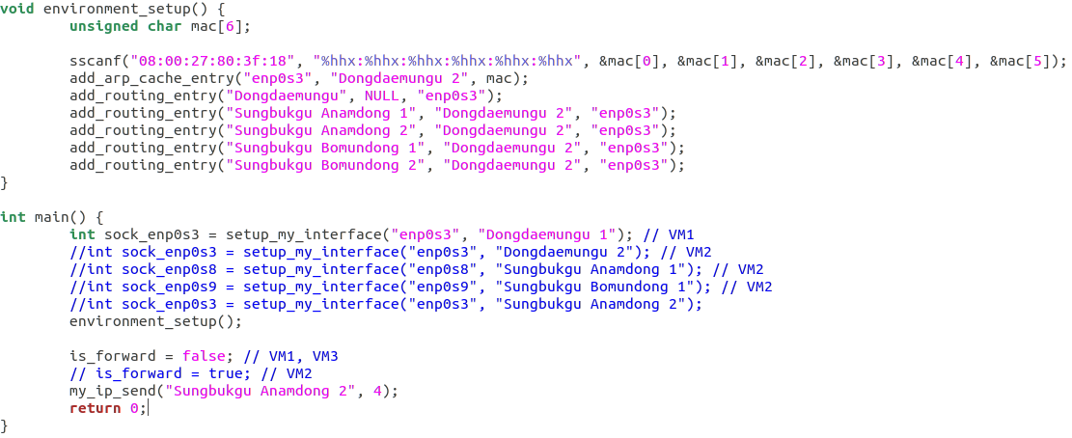
Code (VM1)
VM2 enp0s3 mac

Slide 14
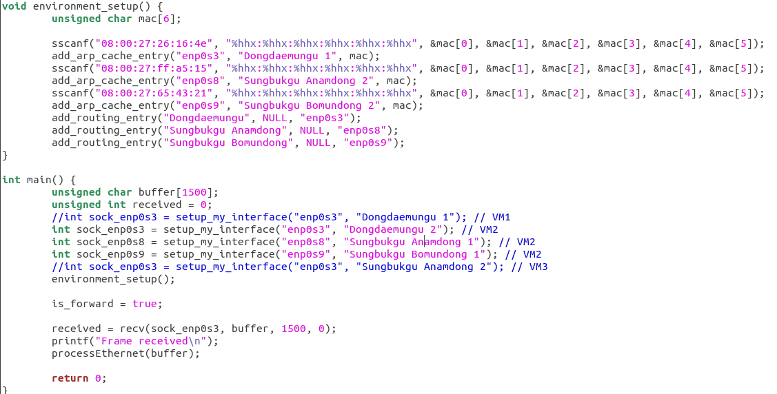
Code (VM2)
VM1 enp0s3 mac
VM3 enp0s3 mac

Slide 15
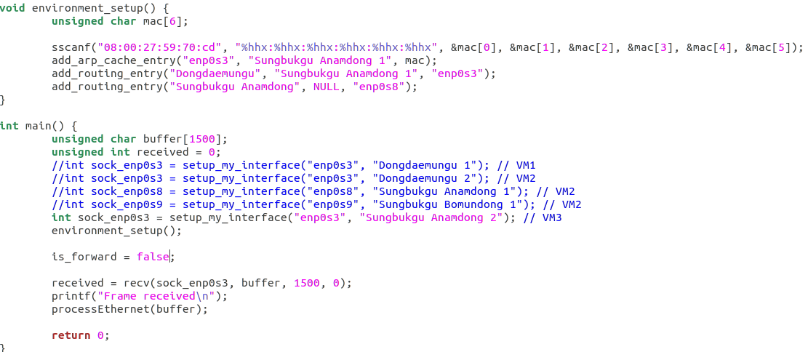
Code (VM3)
VM2 enp0s8 mac

Slide 16
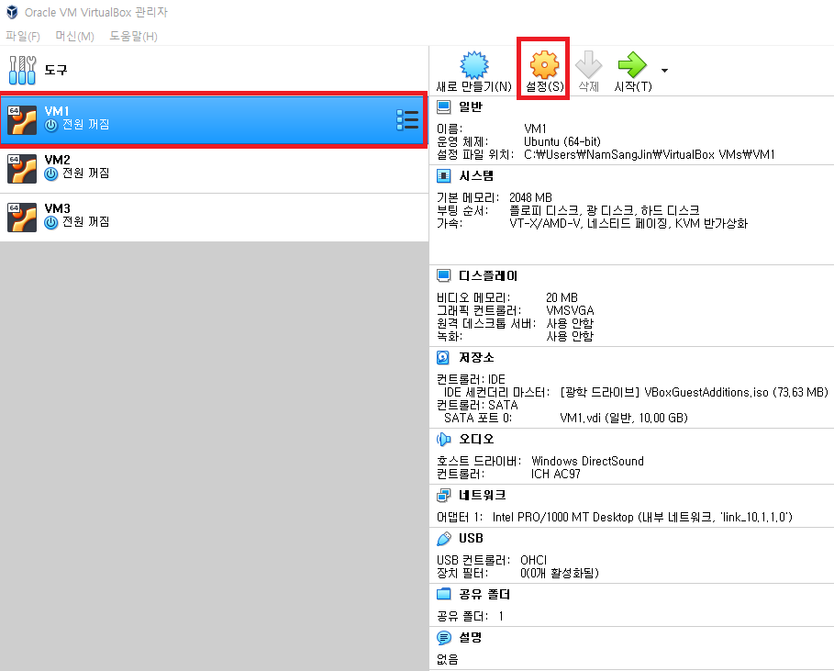
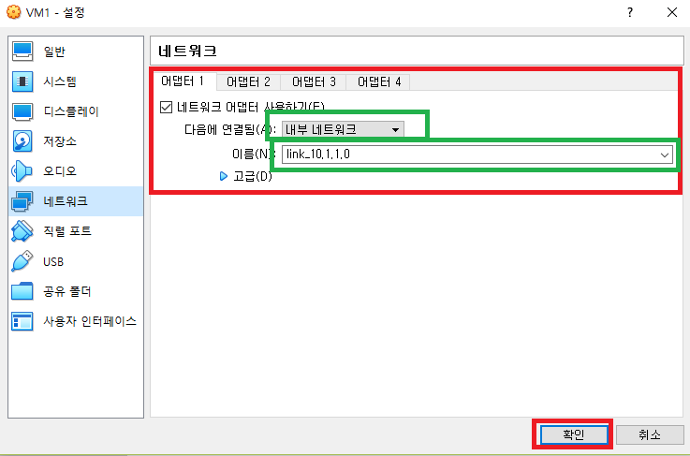
Environment Setup
Repeat this on VM2 and VM3.

Slide 17
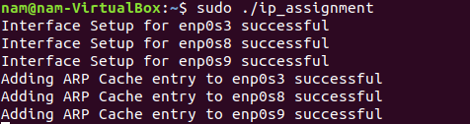

Demo
VM2 is waiting for a packet..
VM3 is waiting for a packet..

Slide 18
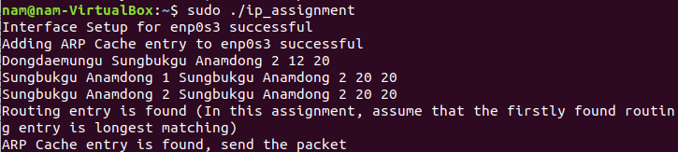
Demo
VM1 sends a packet to VM3
(Sungbukgu Anamdong 2)

Slide 19
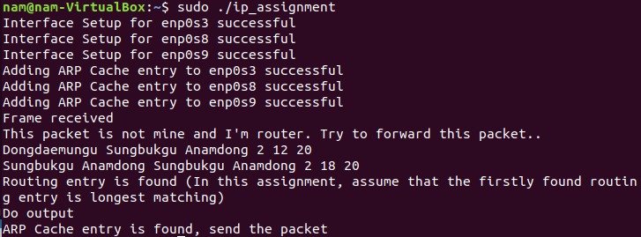
Demo
VM2 forwards the packet

Slide 20
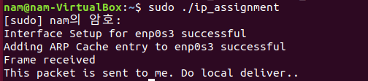
Demo
VM3 receives the packet

Slide 21
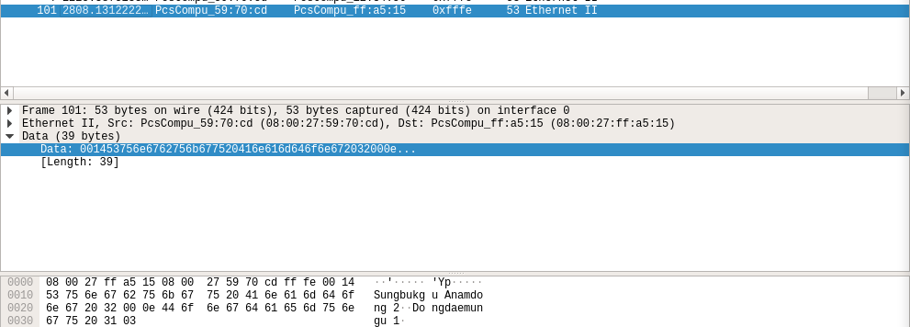
Demo (Wireshark, VM2)

